Slide 1





OOP 2 [N]
Final Project
999 NATIONAL EMERGENCY SERVICE
BD Police
Fire Service
Ambulance

Slide 2
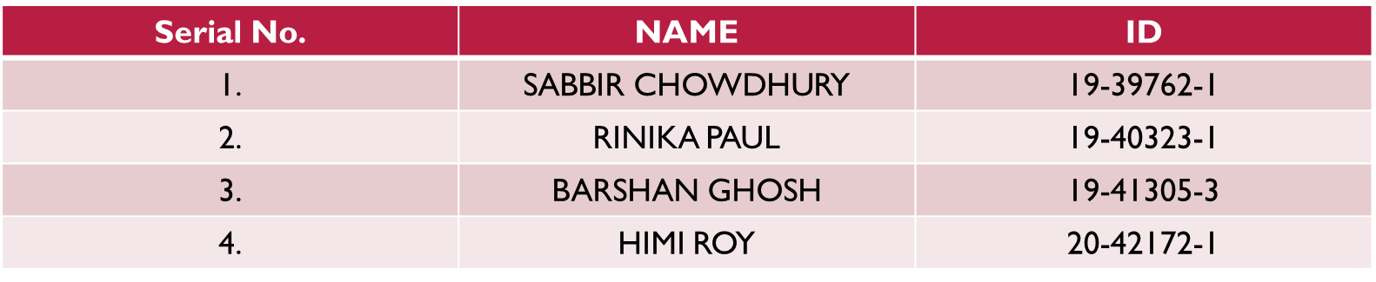
Group Member Details

Slide 3
Objective
It is our little effort to develop a digital country whereby the life of mass people will become easier and simpler.
Most of the cases people face difficulties to meet with the appropriate people to solve their problems and most often they become betrayed. This application will help them to communicate with the appropriate people to solve their miseries.
The user interface of this application is less complex to increase the usage of this project and to provide the proper guidance to all to fulfil their emergency requirements.

Slide 4
MOTIVATION
This app will help to save a life by calling ambulance. Moreover, it will help to communicate with police directly. Furthermore, people can communicate with fire services directly to save their life at danger.
Besides, there are more additional services to make life easier.
This is a "999" system which refers three life related services to make life smother and easier.

Slide 5

Project Details
User
User
Citizen
Admin

Slide 6
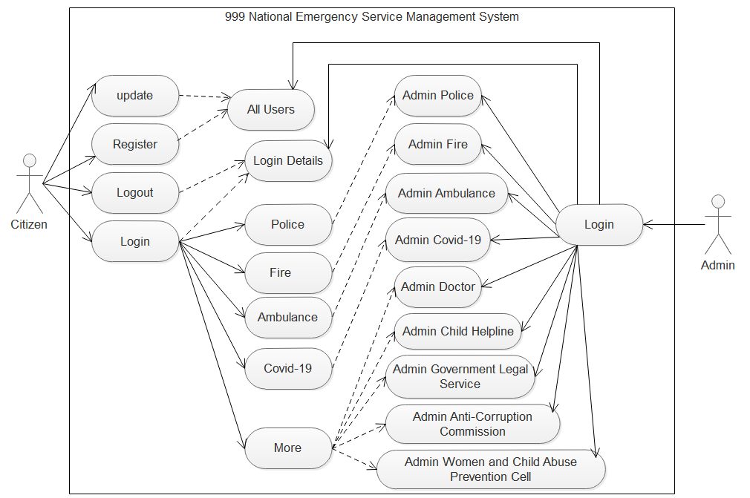
Functionalities

Slide 7
Implementation
User friendly Registration and login System.
User can update his/her personal information without changing NID.
User get 3 Emergency services - Police, Fire, Ambulance.
User get 1 Special service – Covid-19 Special.
User get 5 more options - Doctor, Anti-Corruption Commission, Child Helpline, Women and Child Abuse Prevention Cell & Government Legal Services.
Admin can monitor Registration history and login history.
Admin can add, update and delete any data.
Admin can see the data individually.

Slide 8
Expectation
Add more service option.
When user Login the application show his/her image and name.
Covid-19 service option show 3 more option Special Covid-19 Doctor, Special Covid-19 Hospital, Special Covid-19 Ambulance service.
Show the rating or zone covid-19 affected area.
Show the update this pandemic situation.
Show different Admin panel for different department and they have to login separately.
Auto logout system.
Save user information and auto login.

Slide 9
Limitation
Setup online server.
Live SMS option system.
Live video conference option System.
Auto detect the location of users.
Verify authentic NID and person.
Registration time face detection will match and verify his/her NID photo.

Slide 10
Contribution
Sabbir Chowdhury:
Make UML Diagram Design, Limitation, Implementation, Expectation,
Build the full structure of this management system.
Barshan Ghosh:
Group member details, Objective, Motivation, Thank you, Police dispatcher, Fire Dispatcher, Admin police, Admin Fire, All users, Admin login, Login,
Screen record,
Readme,
Build full database of this management system.
Rinika Paul:
Ambulance, Admin Ambulance, Covid special, Admin Covid special,
Video editing(welcome and thank you page),
Build full GUI of this management system.
Himi Roy:
More, Video editing(background music),
Works some part with team member.

Slide 11
Thank You

